Slide 1
MongoDB for Developers
Module 05 - Aggregations

Slide 2
MongoDB Aggregations – Introduction
Advanced query feature, that enabled to group values from multiple docs, and perform a variety of operations on the grouped data to return a single result
Three types of aggregation in MongoDB:
Aggregation pipeline
MapReduce function
Single purpose aggregation methods

Slide 3
Pipeline Aggregation
Based on the data pipeline processing model
It’s a multi stage pipeline framework that the docs entered into, and transformed into an aggregated result
Alternative to MapReduce and the preferred solution
Each pipeline consists of one or many stages and expressions
Notes:
Preferred solution over MapReduce – the reason is that pipeline provides better performance and more coherent interface
Pay attention that the pipeline operates on the entire collection, which means the entire collection will pass into the aggregation pipeline, Mongo offers two common ways to handle that:
Pipeline stages and indexes – the $match and $sort stages can use the index when they occur at the beginning of the pipeline
Early filtering – if you need to aggregate only on subset of the data collection, use $match, $skip and $limit stages to filter the documents at the first stage, and eliminate the entire collection scan

Slide 4
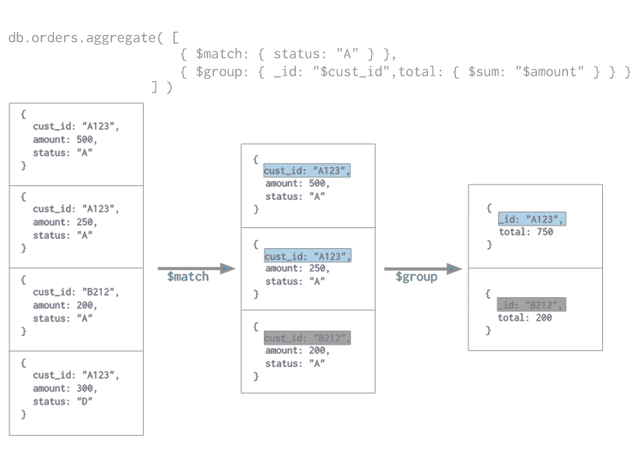
Pipeline Aggregation
Expression
Stages
The $ sign before fields
mark to Mongo to inject the actual value of the field during the execution
Notes:
Each pipeline consists of one or many stages and expressions:
stages – data transformations for each document in the collection as they pass the pipeline
expressions – operands for some of the stages. They specify the transformation(in-memory) to apply to the input docs

Slide 5
Pipeline Aggregation - Stages
Data transformations for each document in the collection as they pass the pipeline
Can filter out some docs, or create new docs
Common stages:
$out – must be the last stage in the pipeline. It writes the resulting docs from the aggregation to a collection
$sort – sort the docs stream by a sort key parameter
$limit – passes the first n docs to the pipeline, where n is a parameter
$count – returns the count of the docs at this stage

Slide 6
Pipeline Aggregation - Expressions
Operands for some of the stages the pipeline
Specify the transformation(in-memory) to apply to the input docs
Common expressions:
$sum – calculates and returns the sum of the numeric values in the group stage
$dayOfYear – returns the day of the year(1-366) for a date field
$gte – returns true if the first value is greater or equal to the second
Notes:
Expressions are generally stateless, except the accumulator expressions that used in the $group stage, which maintain the docs state(e.g.: $max, $min, $sum etc.) as documents pass through the pipeline

Slide 7
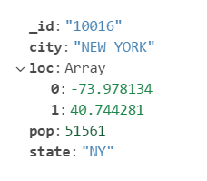
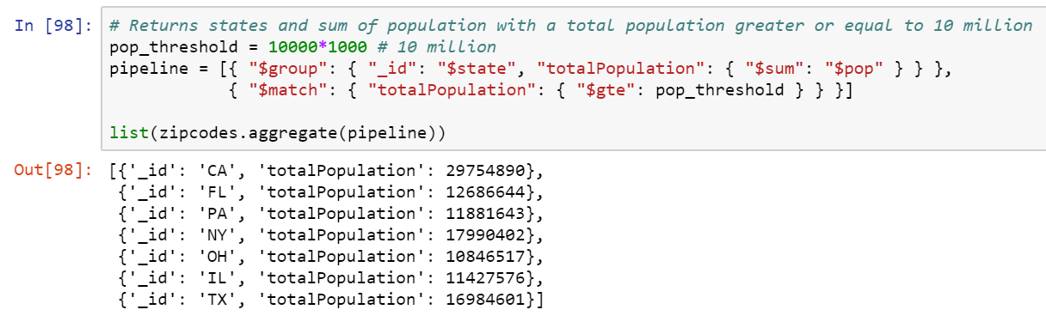
Pipeline Aggregation – Example 1
Example document:
Notes:
Pipeline explain:
Group docs by state(note the $ sign to access fields in the input docs), and for each group calculate the sum of the population
Filter only documents that their population are bigger or equal to 10 million
The _id field is mandatory, and contains the distinct group by key
One can specify an _id value of null, to calculate for example, the sum for all the input docs as a whole

Slide 8
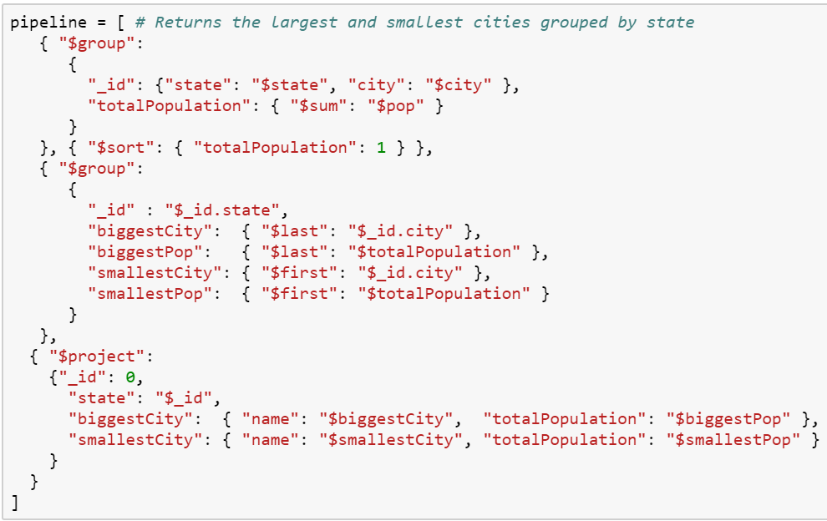
Pipeline Aggregation – Example 2
Notes:
Pipeline explain:
Groups docs by state and city, and for each group calculate the sum of the population
Sort the docs by the totalPopulation
Groups docs by the state and define 4 fields:
biggestCity – using the $last expression to get the id of the biggest city(ordered by the total)
smallestCity – using the $first expression to get the id of the smallest city(ordered by the total)
biggestPop – using the $last expression to get the biggest total population(ordered by the total)
smallestPop – using the $first expression to get the smallest total population (ordered by the total)
Using project, we define the output fields:
Emitting the _id field
Defines state field to hold the _id(which contains the state value)
Defines biggestCity field that contains embedded document with name and total population
Defines smallestCity field that contains embedded document with name and total population

Slide 9
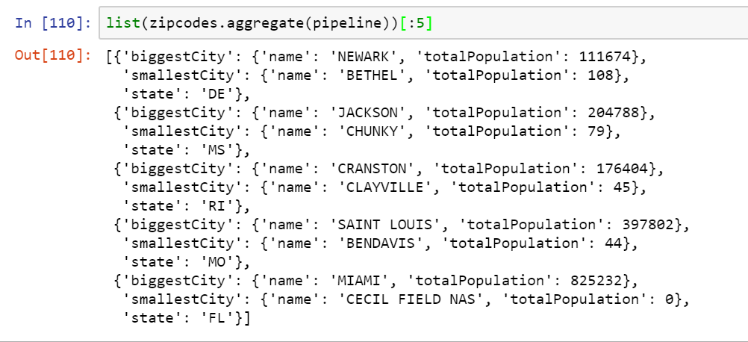
Pipeline Aggregation – Result 2

Slide 10
MapReduce Aggregation - Introduction
Data processing paradigm to process a large amount of data into aggregative results
Consists of two parts:
Map – applies map operation(transformation) to each input documents and emits key-value pairs
Reduce – for keys with multiple values, the reduce collects and condenses the aggregated data

Slide 11
MapReduce Aggregation - Introduction
The map and the reduce functions are JavaScript and run within the mongod process
Take the documents of a single collection as input and can perform any query operation before beginning the map stage
Map reduce provides some flexibility that isn’t presently available in the pipeline aggregation
Notes:
mongod – the primary daemon process for MongoDB
The result of MapReduce can be a document or collection

Slide 12
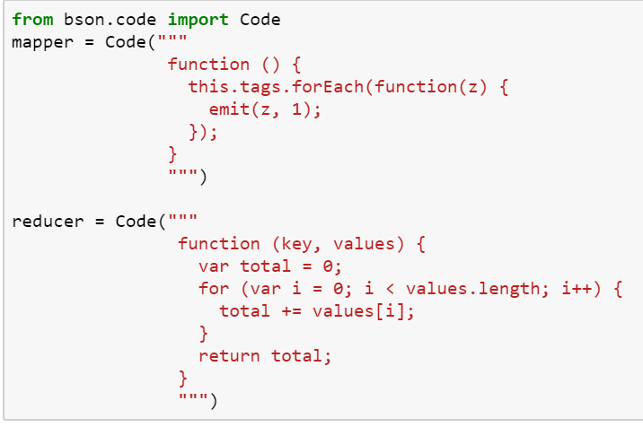
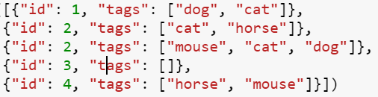
MapReduce Aggregation - Example
Example document:
Notes:
MapReduce explain:
First, we define a mapper, that iterate over the tags array, and for each tag, produce the pair (“tag_name”, 1)
Second, we define the reducer, which get a key value pairs( (“tag_name”, 1) for each tag), and sum the total values for each tag

Slide 13
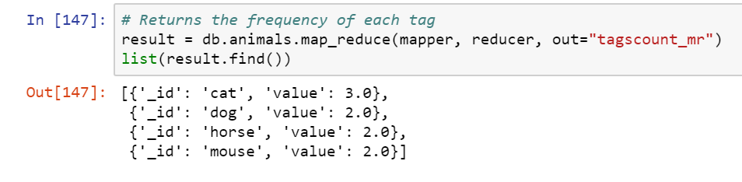
MapReduce Aggregation - Result
Notes:
MapReduce explain:
In the last part, we call the map_reduce function on the animals collection, with the mapper, reducer and collection name as out

Slide 14
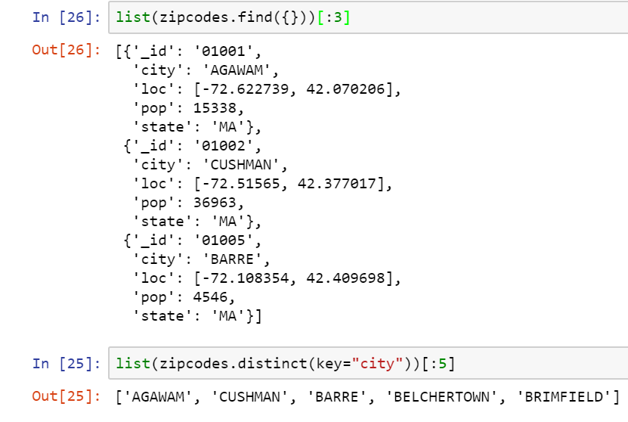
Single Purpose Aggregation
Notes:
Single Purpose Aggregation:
Provide simple access to common aggregation functions
Mongo provides two functions: distinct and count

